Slide 1
18-349: Introduction to Embedded Real-Time Systems
Lecture 9: Transducers
Anthony Rowe
Electrical and Computer Engineering
Carnegie Mellon University

Slide 2
Administrivia
Lab 1
Due Monday
Final Exam
Date: Thursday December 15, 2016
Time: 5:30pm-8:30pm
Location: TBA
Late Policy
Style Points

Slide 3
Late Policy
You can turn in one lab at up to 85% of the original value before December 12th
Labs 0-3 build off of each other (Lab 4 not as much)
More practically, this means that you can utilize time at the start of a new lab to finish the previous lab if you did not complete it. Use as many days as you want until December 12th, but keep in mind you need to finish the newly released lab as well.

Slide 4
Coding Style
Good Comments
Good Use of Whitespace
Line Length (80 characters)
Good Variable Names
Magic Numbers
No “Dead Code”
Modularity of Code
Failure Conditions / Error Checking
Proper Memory Handling
Consistency (stick with one style across the entire file)
If in doubt, refer to: https://www.cs.cmu.edu/~213/codeStyle.html

Slide 5
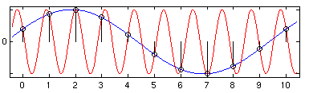
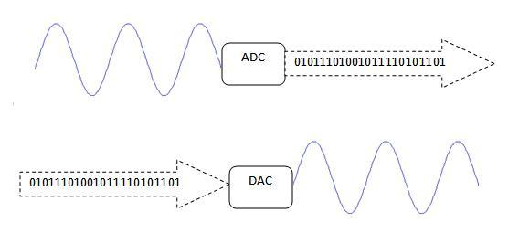
Last Lecture
Analog to Digital Converters
Digital to Analog Converters

Slide 6
Lecture Overview
Sensors
Noise
Time Domain vs. Frequency Domain
Filtering
Actuators

Slide 7
What is a sensor?
A sensor converts a physical phenomenon into an electrical signal
Physical ➔ Electrical
An actuator does the opposite
Electrical ➔ Physical
A transducer is a sensor, actuator, or both

Slide 8
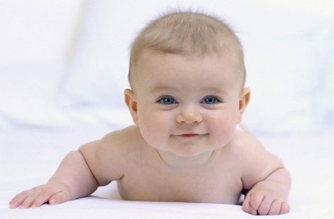
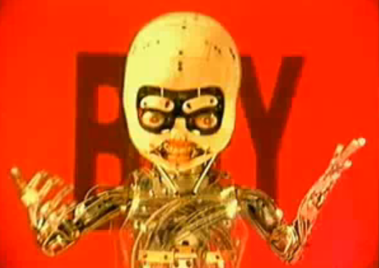
Physical Phenomena
Human Related Senses
Light, Sound, Taste, Smell, Touch, Balance, Temperature, Time
Non-Human Senses
Magnetoreception, Electroreception, Voltage, Current, Capacitance, Resistance

Slide 9
Types of Sensing
Passive Sensing (self-generating)
Sensors that collect energy that is naturally available
Does not interfere with the environment
Examples: Thermocouple, photodiode, piezoelectrics
Active Sensing
Sensors that provide their own “illumination”
Can sense anytime (for example no need to wait for sunlight)
Require additional energy
Examples: RADAR, Microwave Motion, SONAR, RTD

Slide 10
Example Sensors
Property | Sensor | Active/Passive | Output
Temperature | Thermocouple | Passive | Voltage
 | Silicon | Active | Voltage/Current
 | RTD (resistance temperature detector) | Active | Resistance
 | Thermistor | Active | Resistance
Force/Pressure | Strain Gage | Active | Resistance
 | Piezoelectric | Passive | Voltage
Acceleration | Accelerometer | Active | Capacitance
Position | LVDT (linear variable differential transformer) | Active | AC Voltage
 | IR distance | Active | Voltage / Digital
Light Intensity | Photodiode | Passive | Current
 | CMOS Camera | Passive | Digital

Slide 11
Basic Sensing Components
Sensor
Amp.
ADC
Micro-controller
Impedance Matched Signals

Slide 12
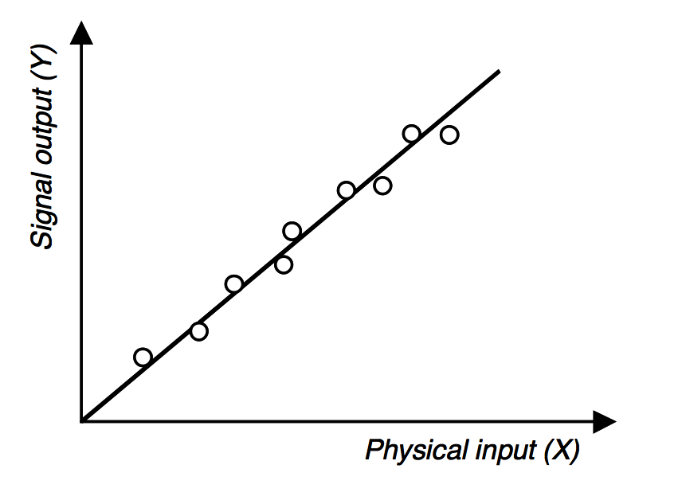
Calibration
The relationship between the physical measurement variable (X) and the signal variable (S)

Slide 13
Sensor Parameters
Range
Lower and upper limits
Resolution
Minimum difference between two measurements
Example: 8bit ADC with 5 volt input
Dynamic Range
Used to measure spread between lower and upper limits
Usually a ratio in decibels (dB)
Dynamic Range = 10 log (Upper Limit / Lower Limit)
Notes:
5Volts / 256 = 0.02 volts

Slide 14
Sensor Parameters
Sensitivity
Slope of calibration curve
Linearity
Closeness of the calibration curve to a specific straight line (least squares fit)
Monotonicity
A curve where the dependent variable always increases or decreases with changes in the independent variable
Hysteresis
Difference between two output values given the same input value depending on the trajectory of the sensor

Slide 15
Sensor Parameters
Bandwidth or Frequency
The speed at which a sensor can provide a stream of meaningful readings

Slide 16
Accuracy, discrimination and precision
Accuracy
Ability to report values close to the TRUE value
Discrimination
Minimal input change required to produce detectable output change
Precision
Repeatability of the reading

Slide 17
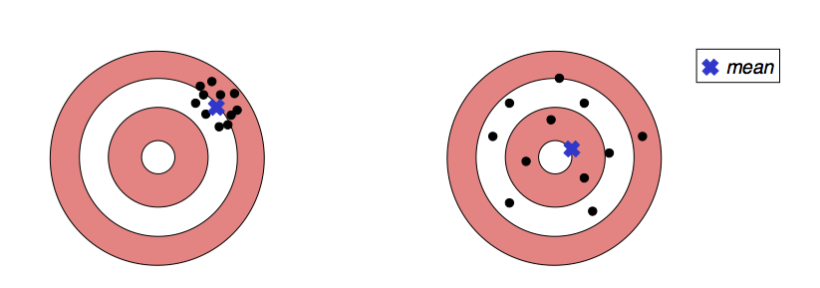
Shooter Example
Discrimination
Size of the hole produced by a shot
Which shooter is more accurate?
Which shooter is more precise?
Shooter #1
Shooter #2
Notes:
Shooter 2 is more accurate
Shooter 1 is more precise

Slide 18
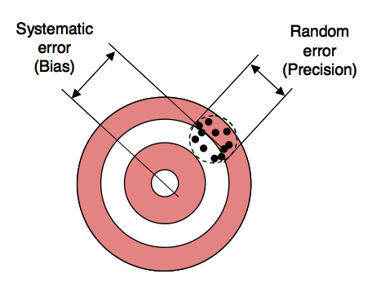
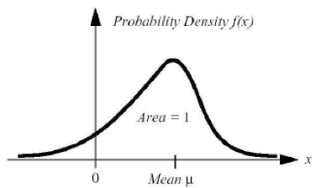
Errors – What can go wrong?
Systematic
Interfering inputs or modifying variables
Drift (mechanical stress)
Measurement process changed (new loading)
Transmission process changed (attenuation)
Random
Noise

Slide 19
Sensor Parameters (Summary)
Parameter | Description
Transfer Function | Mapping between physical input signal and the electrical output signal
Sensitivity | Change in signal vs change in physical input
Dynamic Range | Range over which physical values are differentiated
Accuracy | Largest expected error between reported and true value
Hysteresis | Lag between true and sensed values
Temperature Coefficient | Change due to temperature (not real physical change)
Linearity | Delta from transfer function and a linear equation
Noise | Electronic fluctuations in signal
Resolution | Min detectable signal fluctuation
Bandwidth | Difference in frequency range between finite response times (activation) and the signal decay times (deactivation)

Slide 20
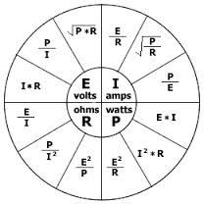
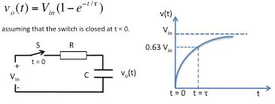
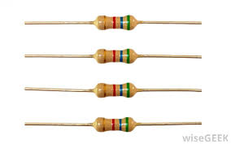
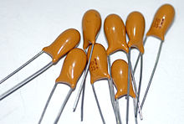
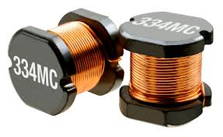
Reading Sensors
Resistive (R)
Capacitive (C)
Inductive (L)

Slide 21
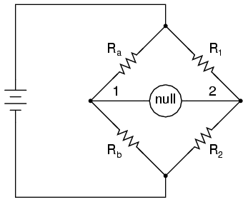
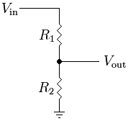
Resistive Sensor
R₁
R_{s}
R_{s}
Voltage Divider
Wheatstone Bridge
Examples: light, temperature

Slide 22
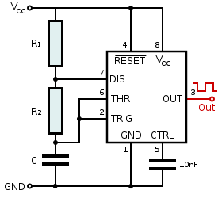
Capacitance
Capacitance to Frequency Converter
Use Timers / Capture Compare Units
Examples: humidity, touch

Slide 23
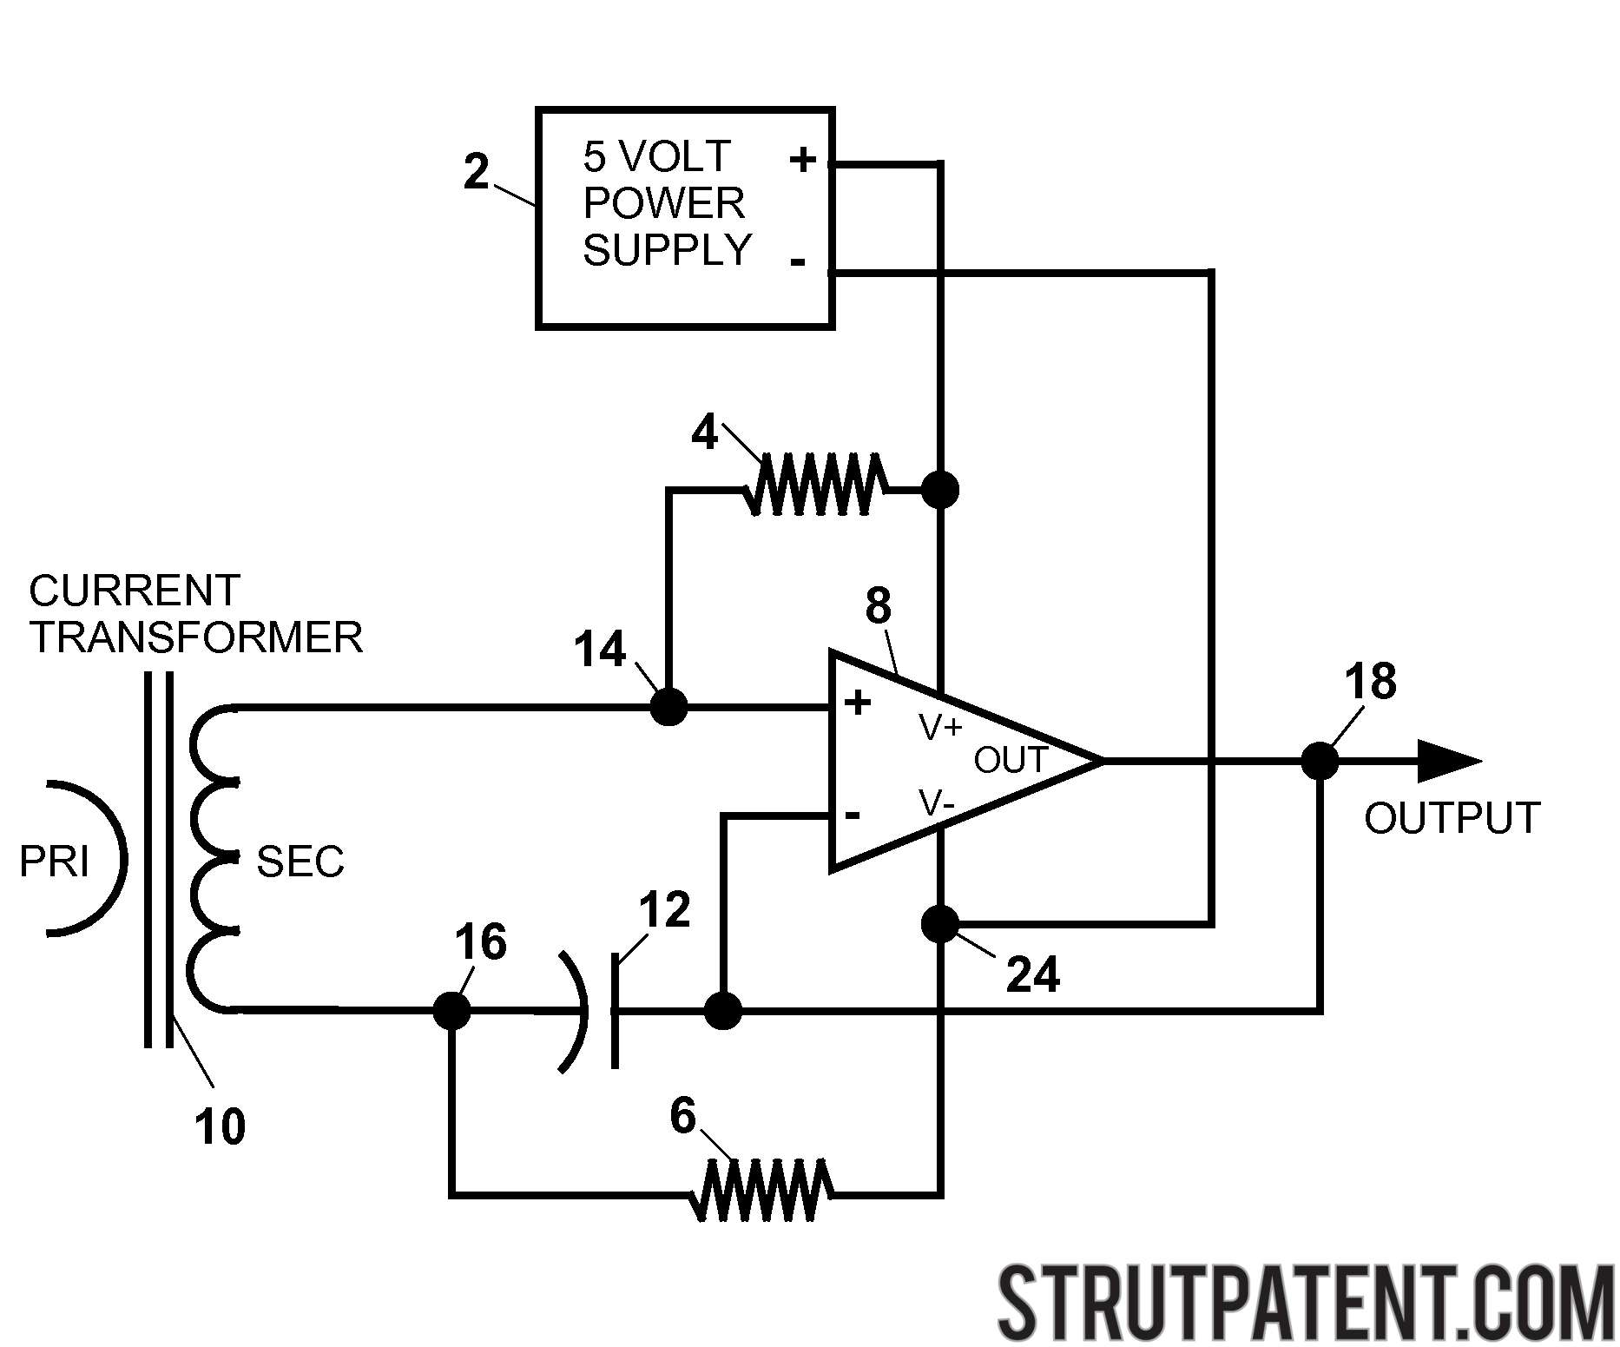
Inductive Sensors
Examples: precise position sensor LVDT

Slide 24
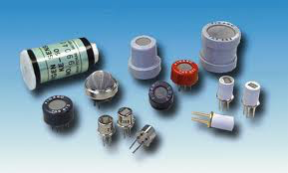
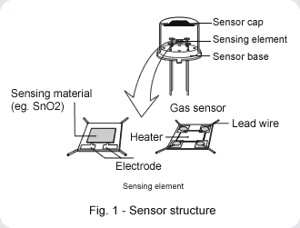
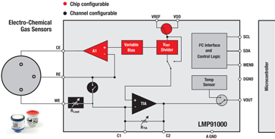
Electro-Chemical
Examples: Gas sensors

Slide 25
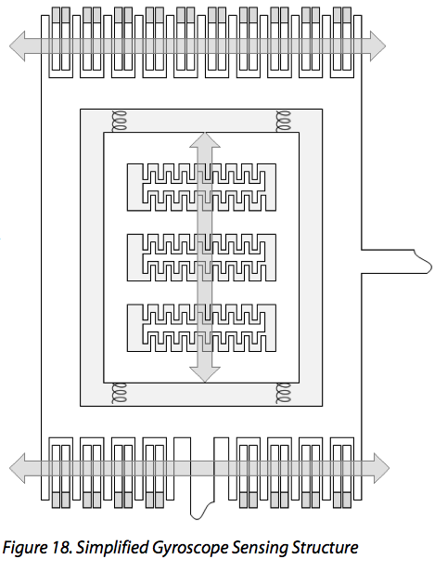
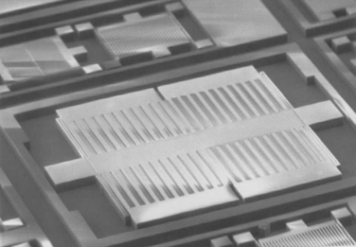
Micro-Electro Mechanical Sensors (MEMS)
Examples: Accelerometer, rate gyro

Slide 26
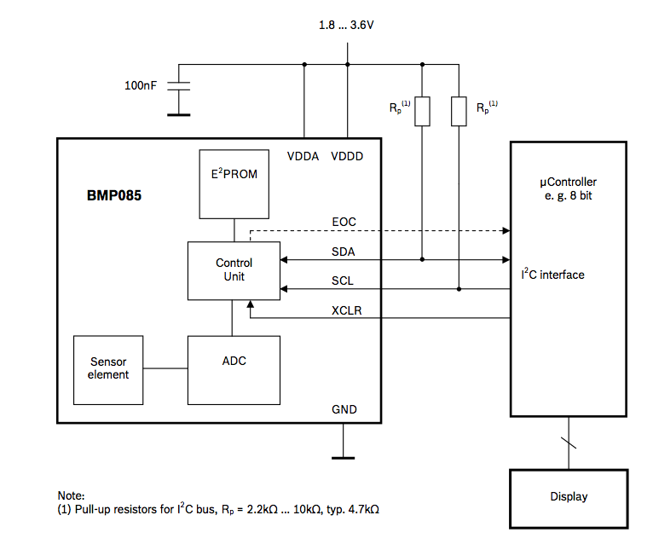
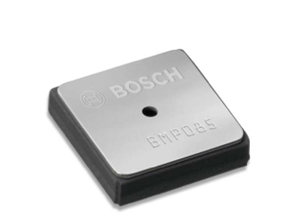
Digital Sensors
Sensor / Amp. / ADC / microcontroller are internal
Example: BMP085 Pressure Sensor

Slide 27
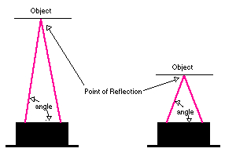
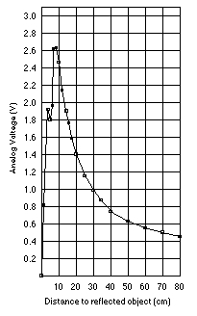
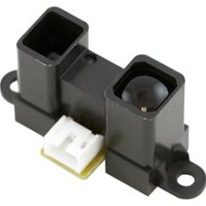
Sharp IR Sensor (Active Sensor)

Slide 28
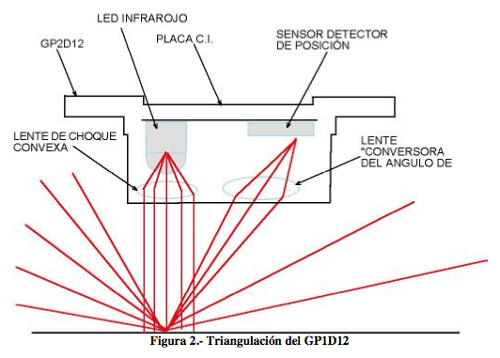
Sharp IR Sensor
IR LED
CMOS Line Sensor
Convex lens
Concave lens

Slide 29
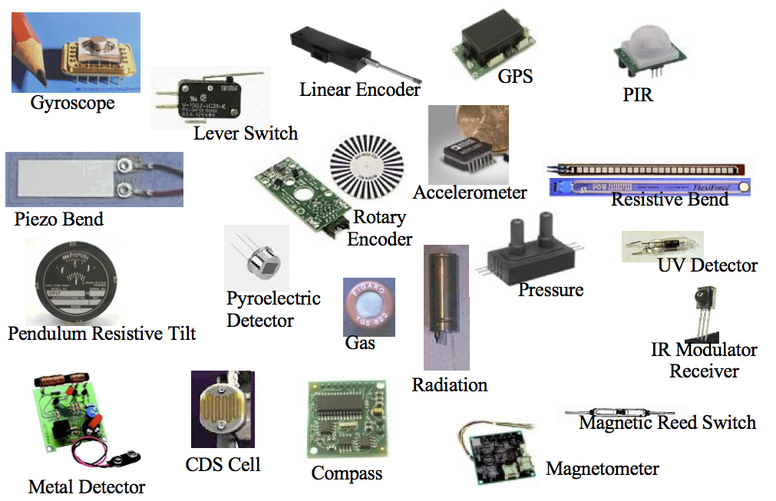
Common Sensors

Slide 30
What is noise?
Unwanted fluctuation in a “reading”
“Electrical Noise”
Electrical signals that make it more difficult to detect or process a signal of interest
Limits sensors, high-speed circuits and RF receivers

Slide 31
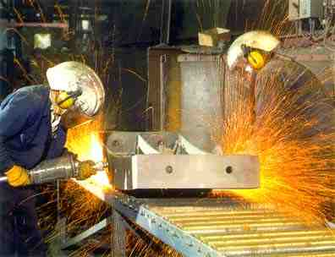
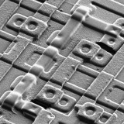
Where does noise come from?
External Sources
Crosstalk, Motors, lightning bolts, surges etc
Material Properties
Thermal excitement, impurities in a conductive channel, semiconductor base currents, …

Slide 32
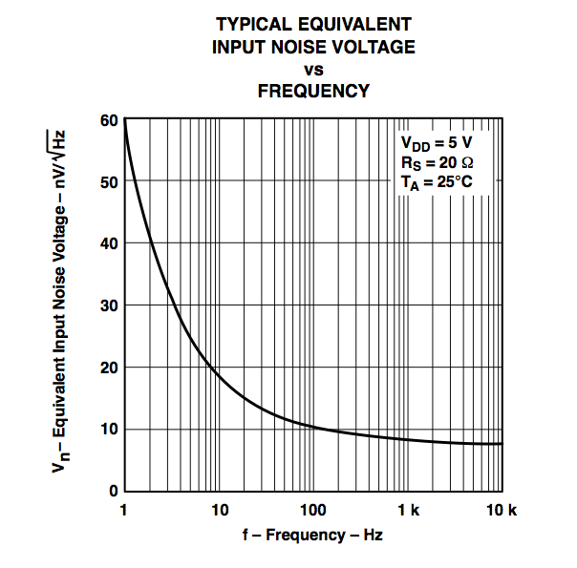
How is noise typically quantified?
“Noise Floor”
Noise level when all inputs are turned off and all outputs are correctly terminated
TLC2201 Op-Amp Noise Specification in data sheet

Slide 33
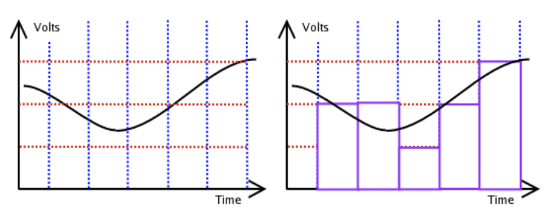
Sampling Rates and Resolution
Analog waveforms are continuous
ADC has a fixed frequency (x-axis)
ADC has a fixed resolution (y-axis)
Nyquist’s Rule: sample at 2x the max freq. of signal

Slide 34
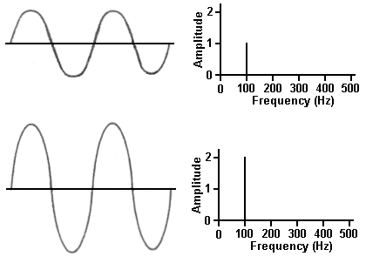
Time and Frequency
Fourier
Transform
Inverse Fourier
Transform
Time Domain
Frequency Domain

Slide 35
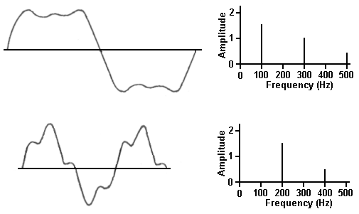
Time and Frequency

Slide 36
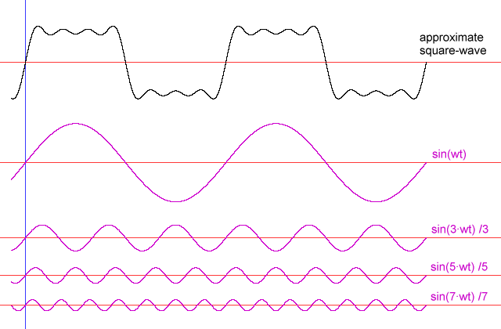
Square Wave Example

Slide 37
Fast Fourier Transform
Fast Fourier Transform (FFT)
Optimized version of the Discrete Fourier Transform (DFT)
Works on buffers with a power of two length (i.e. 512, 1024, 2048)
Amplitude
Amplitude
Time (samples)
Frequency (Hz)
status = fft ( time_s, freq_s );
int time_s = [ 3, 4, 8, 8, 4, 2, 1, 2, 3, 4, 5, 7, 8, 8, 6, 4, 3, 1, 1 ] ;
int freq_s [16];
int freq_s = [ 1, 1, 2, 1, 8, 8, 1, 2, 1, 2, 1, 2, 1, 1, 2, 1 ];

Slide 38
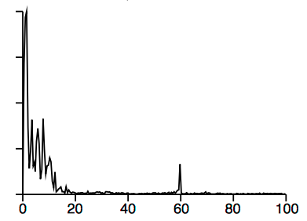
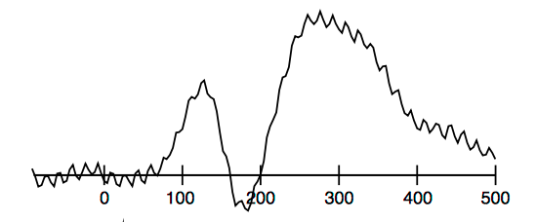
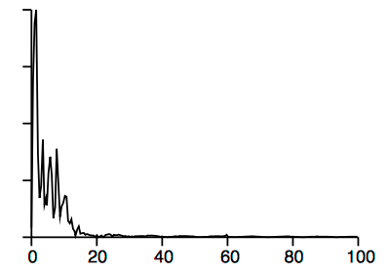
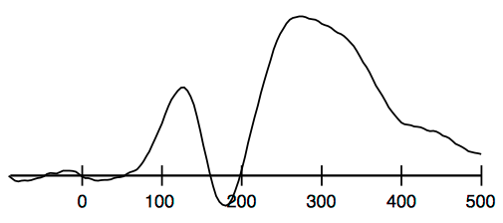
Digital Filtering
FFT
Noise?
Low Pass Filter
Zero out upper frequency values…
iFFT

Slide 39
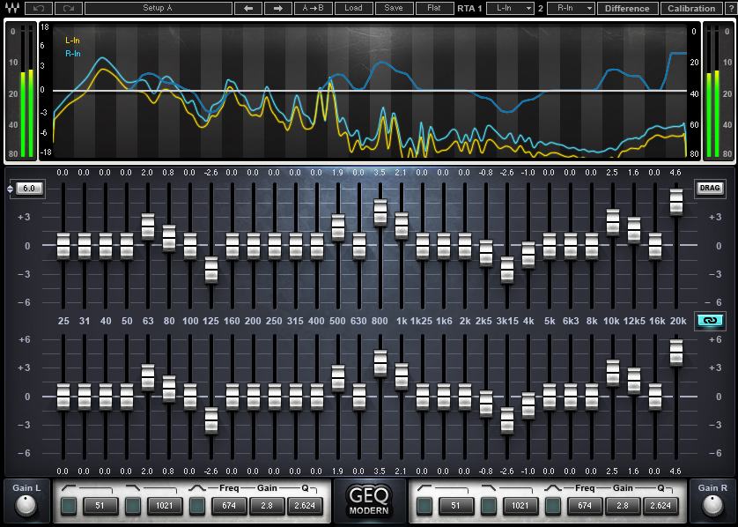
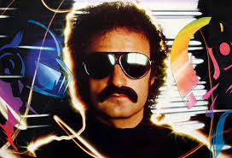
Audio Equalizer

Slide 40
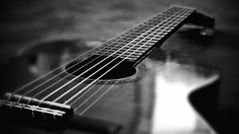

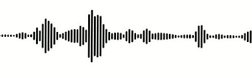
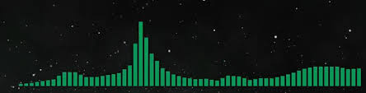
Lab 2: Guitar Tuner
Interrupts and SWI for periodic sampling
Note | Frequency
E | 82.4
A | 110.00
D | 146.83
G | 196.00
B | 246.94
E | 329.63
F=84
F=85
F=84
F=83 …
Periodic sampling
FFT
Peak Detection
Serial Output

Slide 41
What is an Actuator?
Something that converts energy into motion (or applies a force)
Electrical
Motors, Solenoid, Piezoelectric, Electroactive polymers, Speakers, heating coil
Chemical
Animal Muscle, Combustion Engine
Hydraulics
Fluid Pressure

Slide 42
Motor Controller
Encoder
Feedback
Controller (PID)
Sensing
Weak Signal
Motor
H-Bridge
Output
Amplified Signal

Slide 43
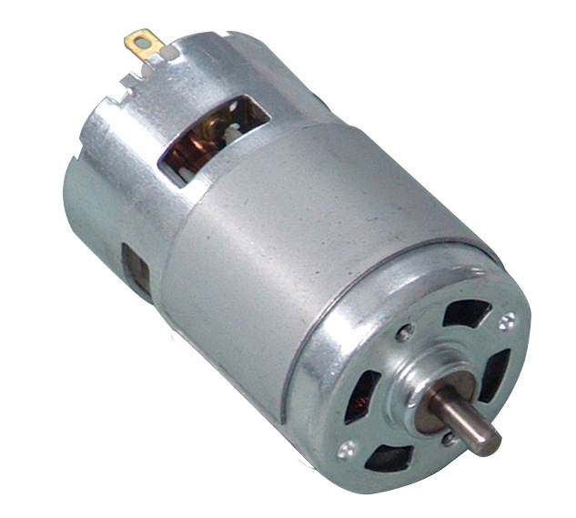
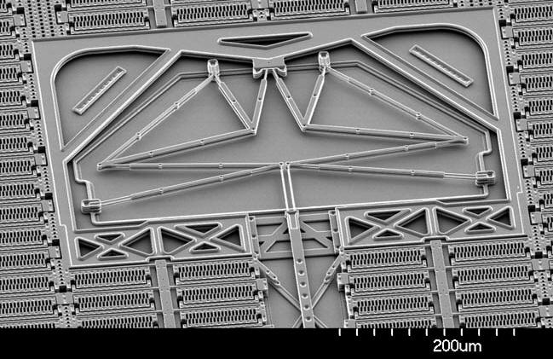
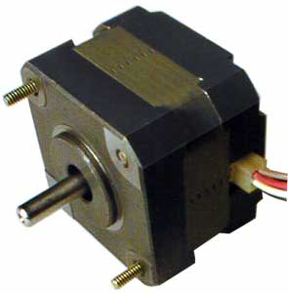
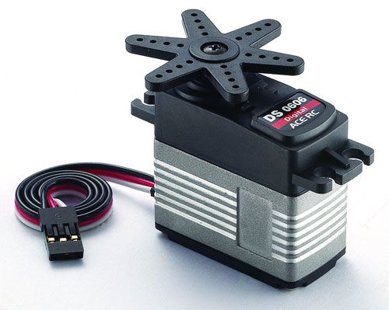
Motors
AC / DC Motor
Magnetic, Electrostatic
Stepper Motor
Brushless motor that moves discrete steps
Can be very accurate without sensing
Servo Motor
Motor with built-in sensing to hold set positions
Usually does not rotate 360 degrees

Slide 44
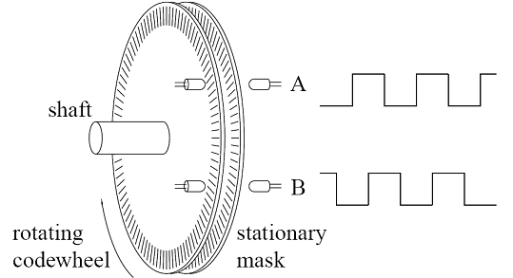

Encoder
00
10
01
11
Grey Code State Machine

Slide 45

H-Bridge Circuit

Slide 46





Servo

Slide 47


Solenoid
Magnet pulling on spring-loaded linear actuator
Used in door locks and valves

Slide 48



Audio
Speaker
Creates arbitrary sound
Buzzer
Creates a single or relatively narrow frequency of sound
Often the oscillator is included

Slide 49

Piezoelectric
Piezoelectric material flexes when a voltage is applied (conversely it generates a voltage when flexed)
Often used in low-profile buzzers

Slide 50
Summary
Sensors
Noise
Time Domain vs. Frequency Domain
Filtering
Actuators
Next: Back to the ARM (SWI)

